Slide 1
SUB. CODE: UIT1401
TITLE: PRINCIPLES OF SOFTWARE ENGINEERING
Prepared By: Dr.V.Arulkumar, Asst.Prof, IT

Slide 2
COURSE OBJECTIVES
● To understand the process and its models.
● To understand fundamental concepts of requirements engineering and Analysis Modelling.
● To understand the major considerations for enterprise integration and deployment.
● To learn various testing and maintenance measures.

Slide 3
COURSE OUTCOME
At the end of the course, the student should be able to
● Identify the key phases in process models.
● Compare different process models.
● Apply the concepts of requirements engineering and Analysis modelling.
● Apply systematic procedure for software design and deployment.
● Compare and contrast various testing and maintenance.

Slide 4
SOFTWARE DESIGN: AN INTRODUCTION

Slide 5
REFERENCES
“Software Design: An Introduction” by David Budgen, Software Engineering Volume 1: The Development Process Pages 209-220
http://atlas.kennesaw.edu/~dbraun/csis4650/A&D/UML_tutorial/index.htm

Slide 6
OVERVIEW
Role of Software Design
Describing Designs
Software Design Practices and Design Methods
Some Software Design Methods

Slide 7
ROLE OF SOFTWARE DESIGN
Question…
  “What exactly is the purpose of Design?
Answer…
  “To produce a workable (implementable) solution to a given problem.”
Fitness for Purpose
  The Key Measure of the Appropriateness of Any Solution

Slide 8
DESIGN – PROBLEM-SOLVING APPROACH
Is There Only One Solution to a Problem?
  Rarely…Almost Never
  Moving House Example
Is There a Systematic Approach to Design?
  No, a Designer Must Create Each System
    Identify the Properties Required
      Stake Holders (Customer, Users, etc.)
    Devise a Structure That Possesses the Properties
What Can a Designer Use in This Effort?

Slide 9
DESIGN – MAIN CHARACTERISTICS
Main Characteristics Found in Almost All Design Problems
  No Single “Right” Solution
  Many Factors and Constraints to be Balanced in Choosing a Solution
  No One Measure of “Quality”
  No Particular Process That Can Ensure That We Can Even Identify an Acceptable Solution

Slide 10
SOFTWARE DESIGN PROCESS
Designer Formulates and Develops an Abstract Design Model Representative of the Solution
Why is This Process Not Understood as Well as Other Forms of Design?
  The Complexity of Software
  The Problem of Conformity
  The (Apparent) Ease of Changeability
  The Invisibility of Software

Slide 11
GAPS IN DOMAIN KNOWLEDGE
Software Design Method
  Used When a Designer Lacks Experience or is Unfamiliar With the Problem to be Solved
  Limited to Forms of Design Practice That Can be Prescribed in a Procedural Manner
These Methods Provide…
  A Representation Part
  A Process Part
  A Set of Heuristics

Slide 12
DESIGN CONSTRAINTS
Designing Software is Rarely an Unconstrained Process
Examples of Constraints
  Programming Language to be Used
  Execution Environment or Operating System
  Performance Expectations
  User Interface Needs

Slide 13
DESIGN IN THE SOFTWARE DEVELOPMENT CYCLE
Constraints Affect the Design Process and the Form of the Product
Set of User Needs to be Met
  Fitness of Purpose
  Requirements Elicitation and Analysis
    Leads to Identifying Inconsistencies Between the Requirements and the Solution
Designer Must “Think Ahead”
  Short Term Use, Long Maintenance Effort, Stability of the Solution Space, etc.

Slide 14
DESIGN QUALITIES
Fitness of Purpose Doesn’t Provide an Absolute Measure of Quality
  Correct and Within Constraints May Not be Enough to Achieve Fitness of Purpose
Quality Factor “ilities”
  Reliability
  Efficiency
  Maintainability
  Usability

Slide 15
ASSESSING DESIGN QUALITY
A Systematic Form of Measurement is Difficult to Achieve
Favorable Assessment Techniques
  Design Walk-through Meetings
  Reviews
  Refactoring (XP)
How Often?

Slide 16
DESCRIBING DESIGNS
Recording the Design Model: Design Viewpoints
Design Representation Forms
Some Examples of Design Representations

Slide 17
DESIGN VIEWPOINTS
Behavior
  Describing the Causal Links Between External Events and System Activities During Execution
Functional
  Describing What the System Does
Structural
  Describing the Interdependencies of the Constructional Components
Data Modelling
  Describing the Relationships that Exist Between the Data Objects Used

Slide 18
DESIGN REPRESENTATION
Forms of Design Representation
  Textual
  Diagrammatical
  Mathematical
Examples
  State Charts
  Data Flow Diagram (DFD)
  Entity Relationship Diagram (ERD)

Slide 19
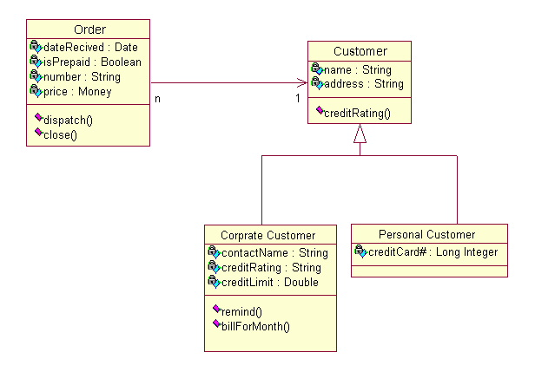
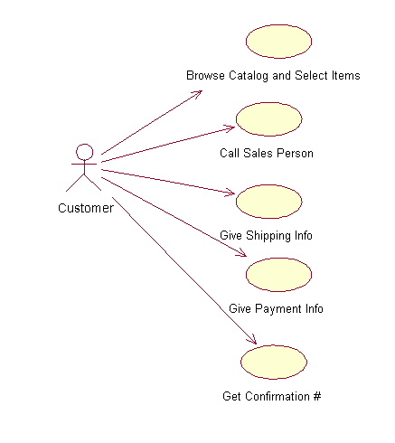
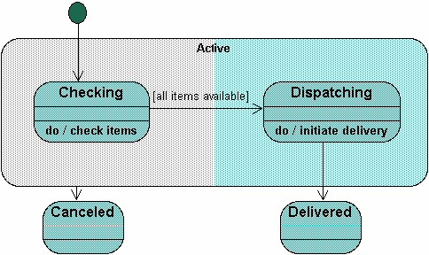
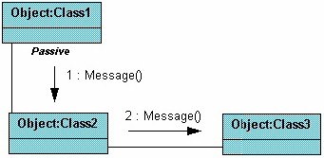
CURRENT DESIGN REPRESENTATIONS
UML Diagrams
  Class
  Use Case
  Collaboration
  Sequence
  Statechart
  Component
  Activity
* http://atlas.kennesaw.edu/~dbraun/csis4650/A&D/UML_tutorial/index.htm

Slide 20
SOFTWARE DESIGN PRACTICES AND DESIGN METHODS
Major Problem with Teaching Software Design is Scale
Roles for Software Design Methods
  Establishing Common Goals and Styles
  Generating “Consistent” Documentation
    Assist With Future Maintenance
    Recapture the Original Design Model
  Helping Make Some Features of a Problem More Explicit
Constraints That Limit Their Usefulness
  The Process Part of a Method Provides Relatively Little Detailed Guidance as to How a Problem Should be Solved
  The Need to Use a Procedural Form Leads to Practices That Conflict with the Behavior Observed in Experienced Designers

Slide 21
DESIGN STRATEGIES
Top-down
  Separate a Large Problem into Smaller Ones
Compositional
  Identifies a Set of “Entities” That Can be Modeled and Then Assembled to Create a Model for the Complete Solution
Organizational
  Use Where Development Organization and Management Structures Impose Constraints Upon the Design Process
Template
  Used Where Some General Paradigm Describes a Reasonably Large Domain of Problems

Slide 22
SOFTWARE DESIGN METHODS
Jackson Structured Programming (JSP)
Structured Systems Analysis and Structured Design
Jackson System Development (JSD)
Object Oriented Design (OOD)

Slide 23
FINAL THOUGHTS
The Paper was Stale Given the Progress That Software Design has Gone Through the Last 10 Years
  A More Recent Paper Linking the First Generation Design Methods with the Current Design Methods
Fitness of Purpose is a Good Concept for Use in Guiding a Software Project

Slide 24

QUESTIONS?

